Slide 1


Survival Prediction of Extracorporeal Membrane Oxygenation Treatment on Patients with Acute Respiratory Distress Syndrome
Robert Edwards
Notes:
Today I will be talking about survival prediction on patients with ARDS

Slide 2
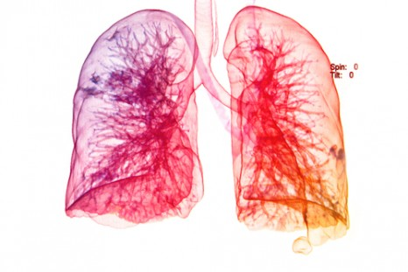
Introduction
Project background
Aims of the project
Exploratory data analysis
Methods
Analysis Plan

Slide 3
Project Background

Slide 4
Acute Respiratory Distress Syndrome (ARDS)
A type of respiratory failure characterized by rapid onset of widespread inflammation in the lungs^{[1]}
Diagnosis based on:
low blood oxygen levels
absence of cardiac failure as primary diagnosis
Prevalence of 10% among critically ill patients worldwide^{[2,3]}
30-40% mortality^{[2,3]}
[1] an E, Brodie D, Slutsky AS. Acute Respiratory Distress Syndrome: Advances in Diagnosis and Treatment. JAMA. 2018 Feb 20;319(7):698-710. doi: 10.1001/jama.2017.21907. Review. PubMed PMID: 29466596.
[2] Rubenfeld GD, Caldwell E, Peabody E, et al. Incidence and outcomes of acute lung injury. N Engl J Med 2005; 353: 1685–93.
[3] Bellani G, Laffey JG, Pham T, et al. Epidemiology, patterns of care, and mortality for patients with acute respiratory distress syndrome in intensive care units in 50 countries. JAMA 2016; 315: 788–800.
Notes:
https://www.nhs.uk/conditions/acute-respiratory-distress-syndrome/
Acute respiratory distress syndrome (ARDS) is a life-threatening condition where the lungs can't provide the body's vital organs with enough oxygen.
It's usually a complication of a serious existing health condition. Most people have therefore already been admitted to hospital by the time they develop ARDS.
Symptoms of ARDS can include:
severe shortness of breath
rapid, shallow breathing
tiredness, drowsiness or confusion
feeling faint

Slide 5
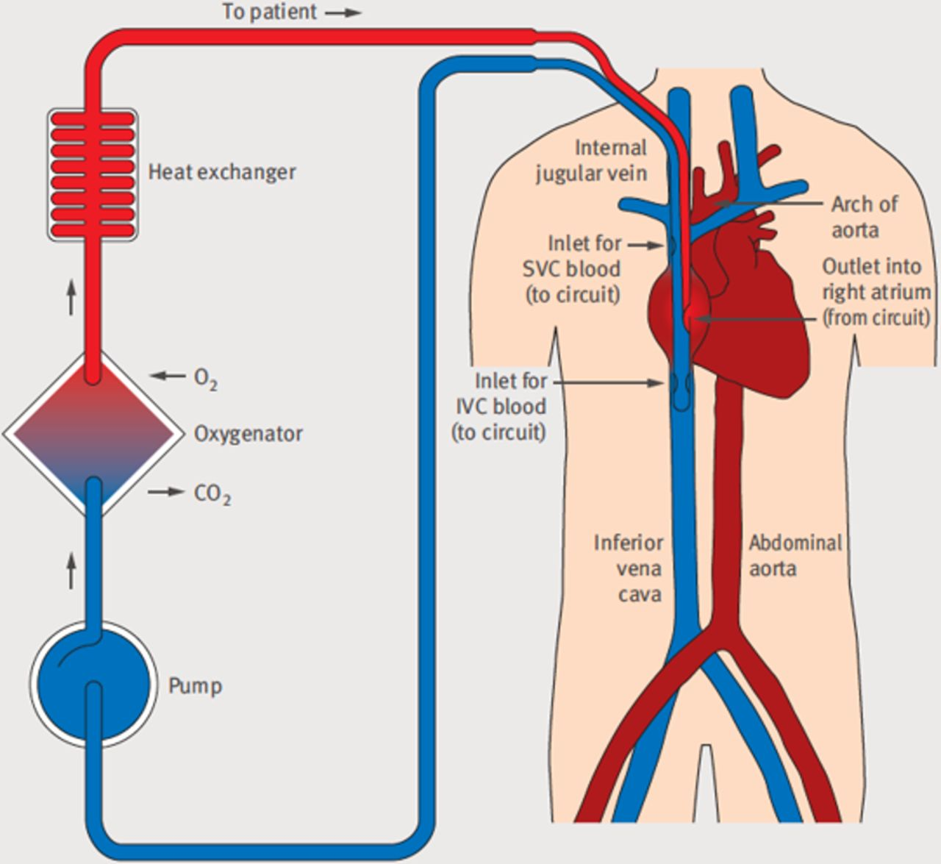
Extracorporeal Membrane Oxygenation
Extracorporeal membrane oxygenation (ECMO)
A method of providing extended cardiac and respiratory support in patients with insufficient gas exchange to sustain life
Research suggests it could help with ARDS patients^{[4,5]}
[4] Peek, GJ; Moore, HM; Moore, N; Sosnowski, AW; Firmin, RK (1997). "Extracorporeal membrane oxygenation for adult respiratory failure". Chest.
[5] Lewandowski, K.; Rossaint, R.; Pappert, D.; Gerlach, H.; Slama, K.-J.; Weidemann, H.; Frey, D. J. M.; Hoffmann, O.; Keske, U. (1997). "High survival rate in 122 ARDS patients managed according to a clinical algorithm including extracorporeal membrane oxygenation". Intensive Care Medicine.
[6] (image) Ali J, Vuylsteke A. Extracorporeal membrane oxygenation: indications, technique and contemporary outcomes. Heart. 2019 Apr 30;. doi: 10.1136/heartjnl-2017-311928. [Epub ahead of print] PubMed PMID: 31040171.
Notes:
1. Current treatment for ARDS is Mechanical Ventilation
2. A method of providing extended cardiac and respiratory support in patients with insufficient gas exchange or perfusion to sustain life
Early studies had shown survival benefit with use of ECMO for people in acute respiratory failure especially in the setting of acute respiratory distress syndrome.^{[6][7]}
Peek, GJ; Moore, HM; Moore, N; Sosnowski, AW; Firmin, RK (1997). "Extracorporeal membrane oxygenation for adult respiratory failure". Chest.
Lewandowski, K.; Rossaint, R.; Pappert, D.; Gerlach, H.; Slama, K.-J.; Weidemann, H.; Frey, D. J. M.; Hoffmann, O.; Keske, U. (1997). "High survival rate in 122 ARDS patients managed according to a clinical algorithm including extracorporeal membrane oxygenation". Intensive Care Medicine.
https://www.semanticscholar.org/paper/Fifty-Years-of-Research-in-ARDS.-Is-Extracorporeal-Leprince-Pesenti/ca0ada0ed074e8c7c09fe0fdfe2f084be0758563

Slide 6
Aims of Project
Can PreECMO biomedical markers be used to accurately predict survival after ECMO treatment?
Do we need all PreECMO variables or just a subset to make accurate predictions?
What is the expected performance of future predictions?
Notes:
**Should this have a title slide?

Slide 7
Exploratory Data Analysis

Slide 8
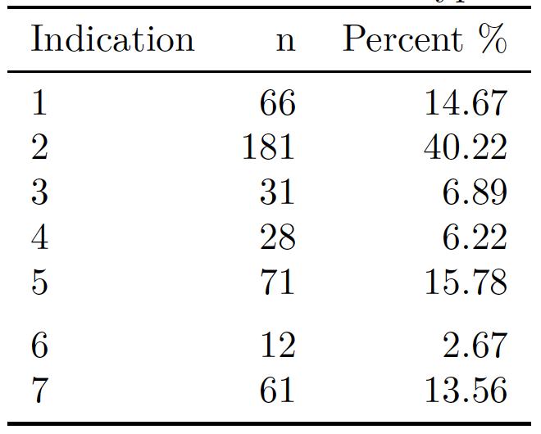
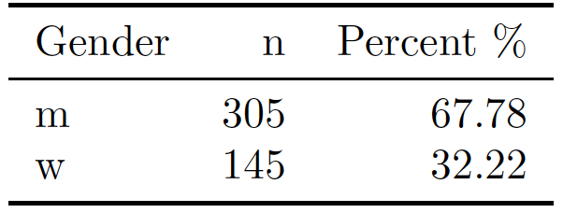
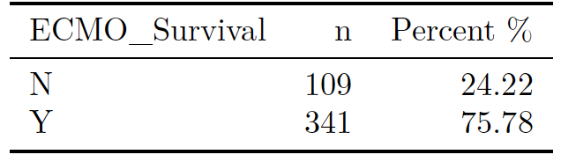
The Data
450 patients diagnosed with ARDS
33 explanatory variables
2 Categorical
31 Continuous
Binary response
Notes:
Imbalanced Data
Response variable ECMO_Survival
Gender
Disease Indication

Slide 9
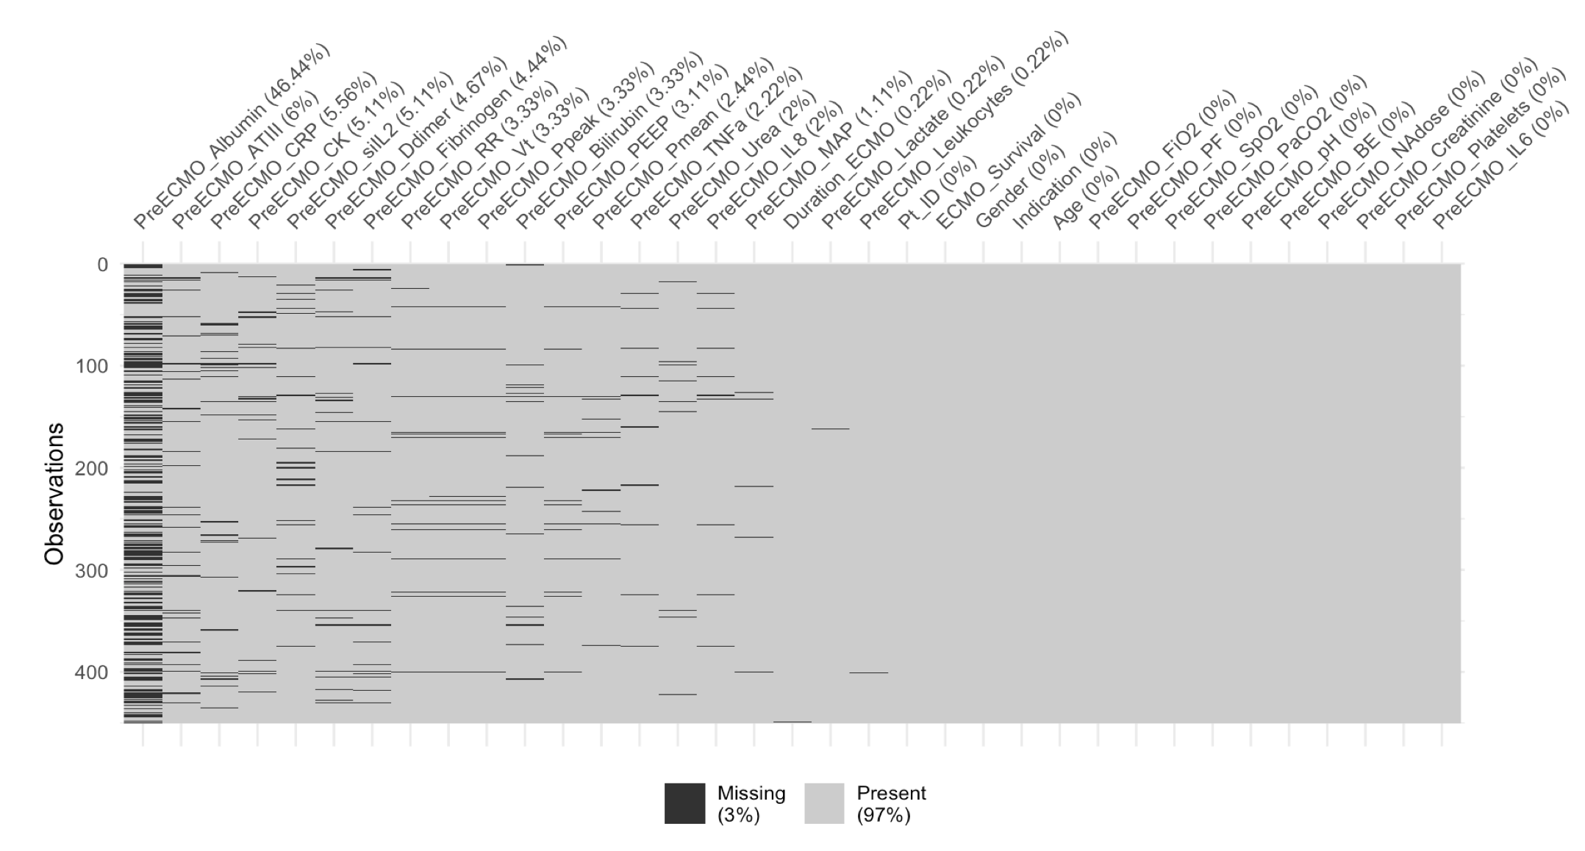
Missing Data
Drop

Slide 10
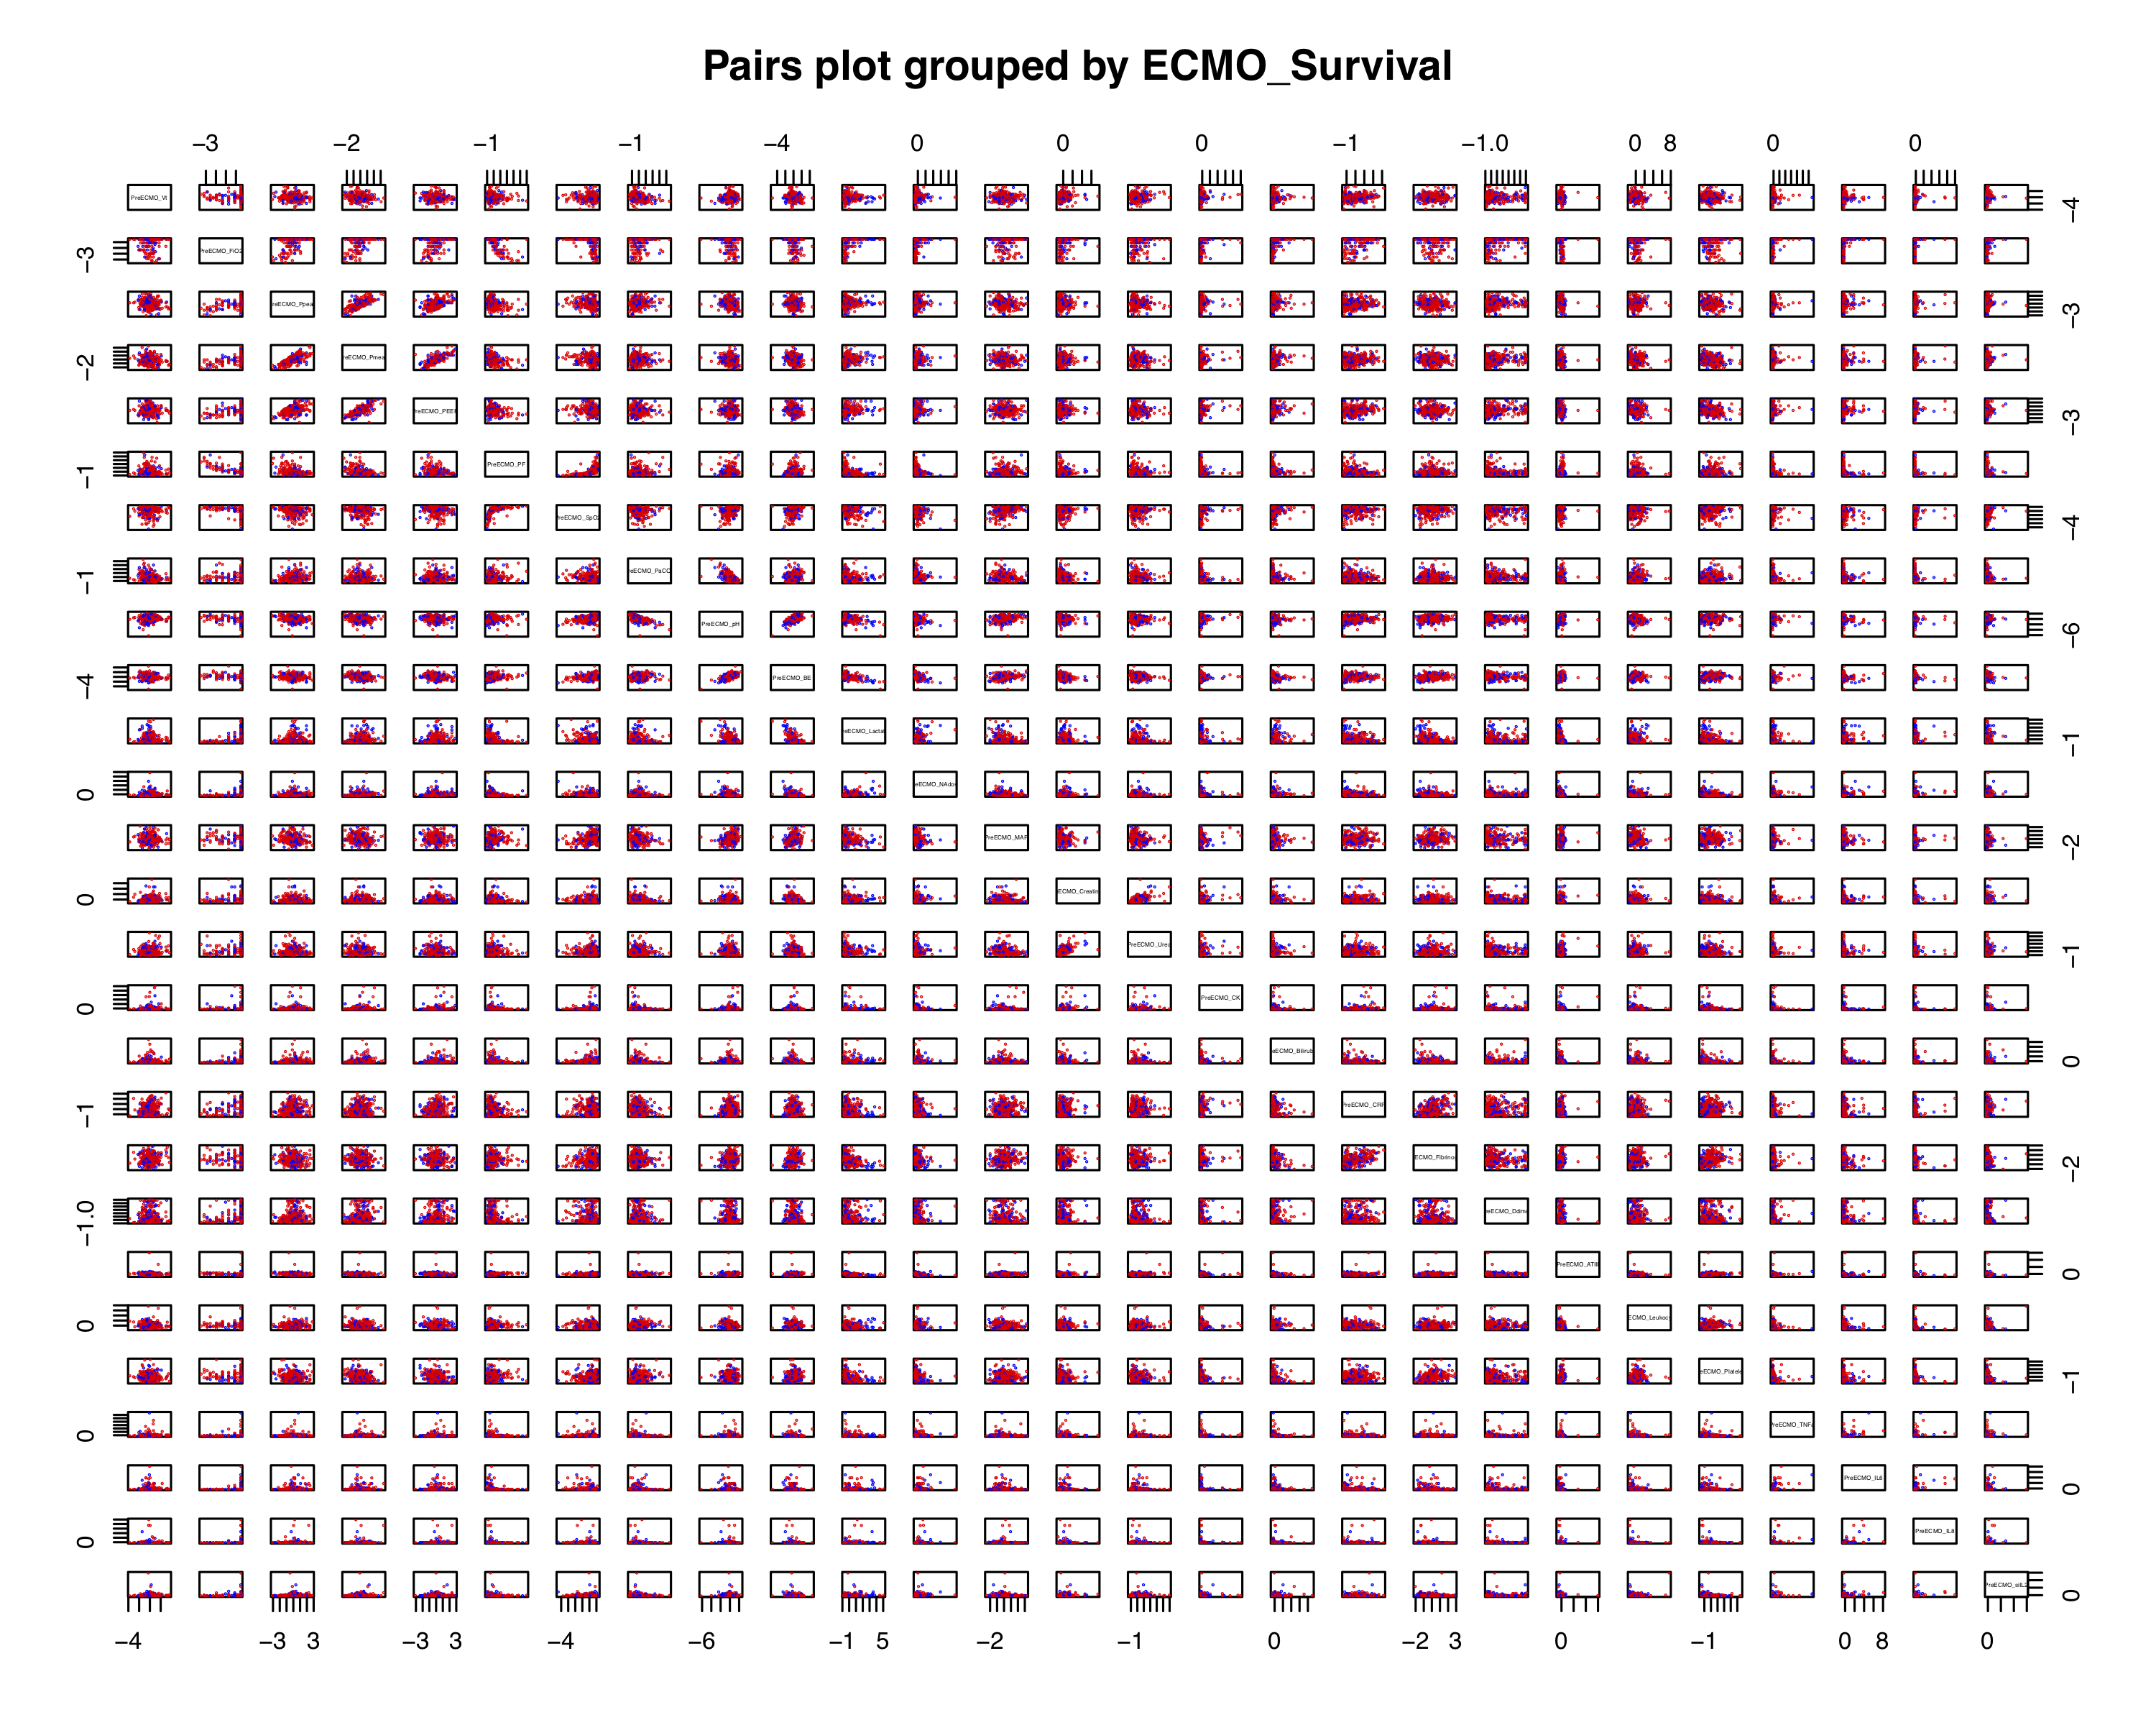
Pairs Plot
ECMO_Survival
Yes
No
Notes:
No clear linear separations in ECMO_Survival
Variables showing some group distinction:
PreECMO_Lactate
PreECMO_pH

Slide 11
Methods

Slide 12
Models
Split Data
(train / validation / test)
Methods
Train Models
(training set)
Logistic Regression + LASSO
LDA
QDA
KNN
Random Forest
Support Vector Classifier
Model Selection
(validation set)
Accuracy
ROC
AUC
F1 Score
Future Performance
(test set)
Notes:
ROC “Receiver Operating Curve” – False Positive Rate vs. True Positive Rate
AUC – Area Under Curve
F1 Score – Harmonic mean between precision and recall

Slide 13
Analysis Plan

Slide 14
Analysis Plan
Listwise Deletion
(n = 313)
Split Data
Train Models
Model Selection
Future Performance
Notes:
Split slide into Standard and Advanced

Slide 15
Missing Data

Slide 16
Analysis Plan
Listwise Deletion
(n = 313)
Mean Imputation
(n = 450)
MICE Imputation
(n = 450)
Advanced Analysis
Split Data
Split Data
Split Data
Train Models
Train Models
Train Models
Model Selection
Model Selection
Model Selection
Future Performance
Future Performance
Future Performance
Notes:
Split slide into Standard and Advanced

Slide 17
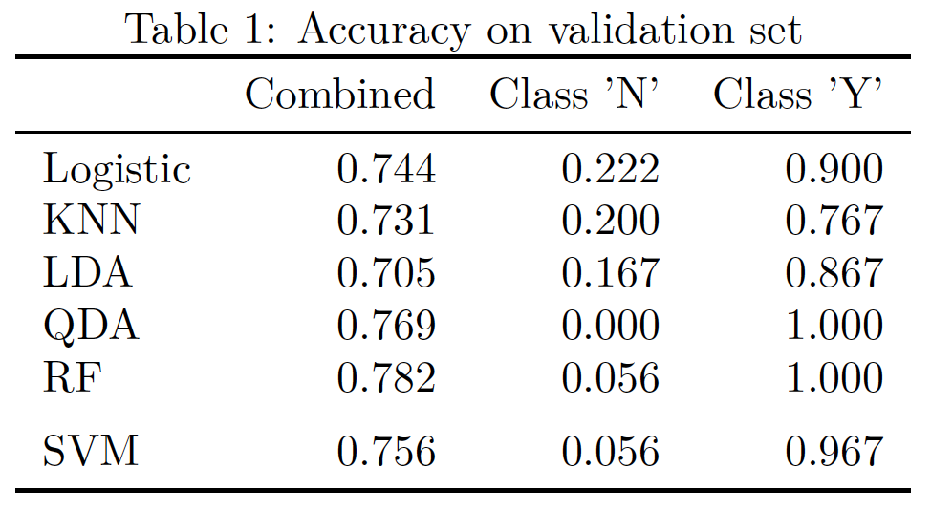
Standard Analysis
Initial results from standard analysis
Poor prediction on non survival
*Error Rate
Notes:
Imbalanced Data
Haven’t finished model selection

Slide 18
Summary
Survival Prediction
450 patients diagnosed with ARDS
Imbalanced Data
Missing Data
Imputation
Notes:
Imbalanced Data
Response variable ECMO_Survival
Gender
Disease Indication

Slide 19

Questions?
2416963E@student.gla.ac.uk

Slide 20
Bibliography
[1] an E, Brodie D, Slutsky AS. Acute Respiratory Distress Syndrome: Advances in Diagnosis and Treatment. JAMA. 2018 Feb 20;319(7):698-710. doi: 10.1001/jama.2017.21907. Review. PubMed PMID: 29466596.
[2] Rubenfeld GD, Caldwell E, Peabody E, et al. Incidence and outcomes of acute lung injury. N Engl J Med 2005; 353: 1685–93.
[3] Bellani G, Laffey JG, Pham T, et al. Epidemiology, patterns of care, and mortality for patients with acute respiratory distress syndrome in intensive care units in 50 countries. JAMA 2016; 315: 788–800.
[4] Peek, GJ; Moore, HM; Moore, N; Sosnowski, AW; Firmin, RK (1997). "Extracorporeal membrane oxygenation for adult respiratory failure". Chest.
[5] Lewandowski, K.; Rossaint, R.; Pappert, D.; Gerlach, H.; Slama, K.-J.; Weidemann, H.; Frey, D. J. M.; Hoffmann, O.; Keske, U. (1997). "High survival rate in 122 ARDS patients managed according to a clinical algorithm including extracorporeal membrane oxygenation". Intensive Care Medicine.
[6] (image) Ali J, Vuylsteke A. Extracorporeal membrane oxygenation: indications, technique and contemporary outcomes. Heart. 2019 Apr 30;. doi: 10.1136/heartjnl-2017-311928. [Epub ahead of print] PubMed PMID: 31040171.

Slide 21
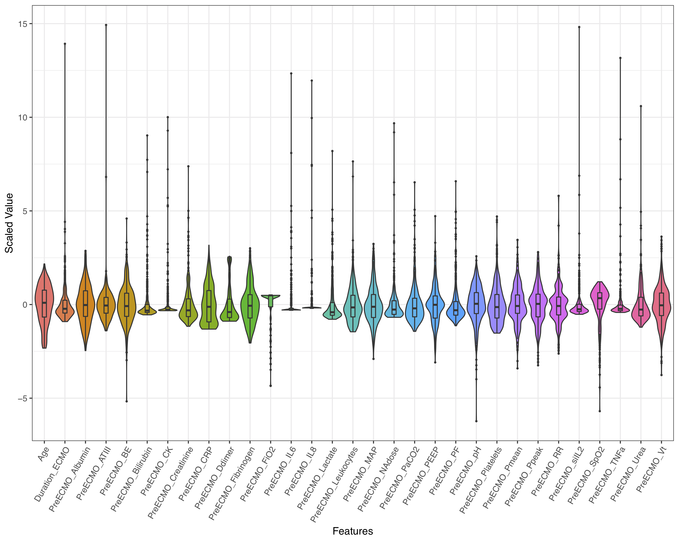
Violin Plot
Notes:
Many outliers
Highly skewed data

Slide 22
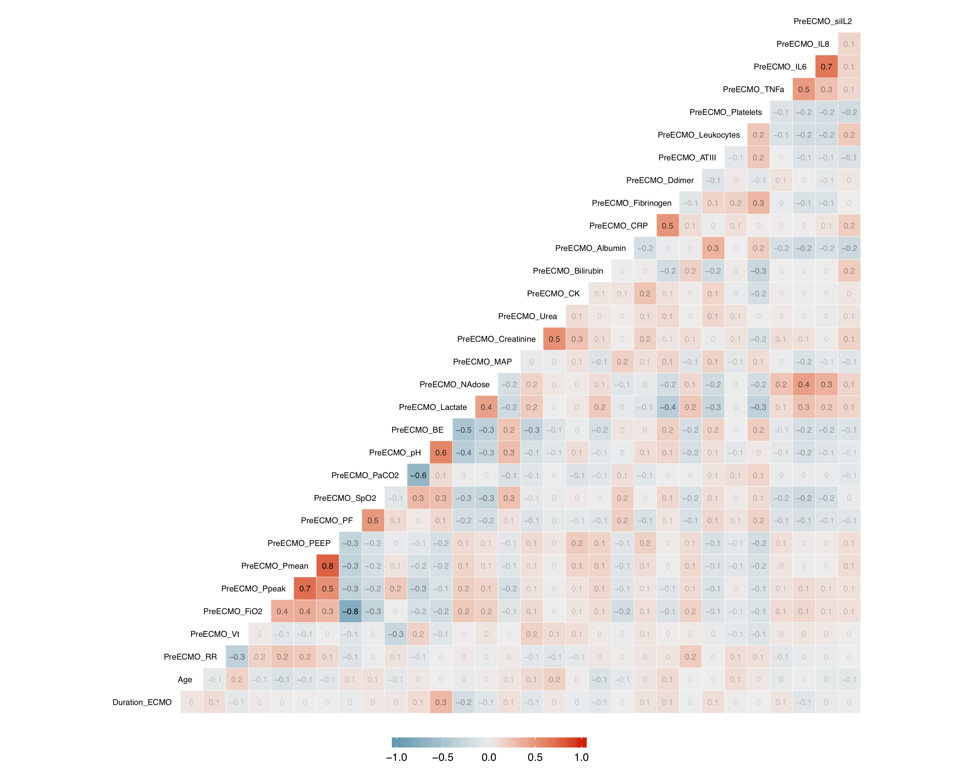
Heatmap
Notes:
Many outliers
Highly skewed data

Slide 23
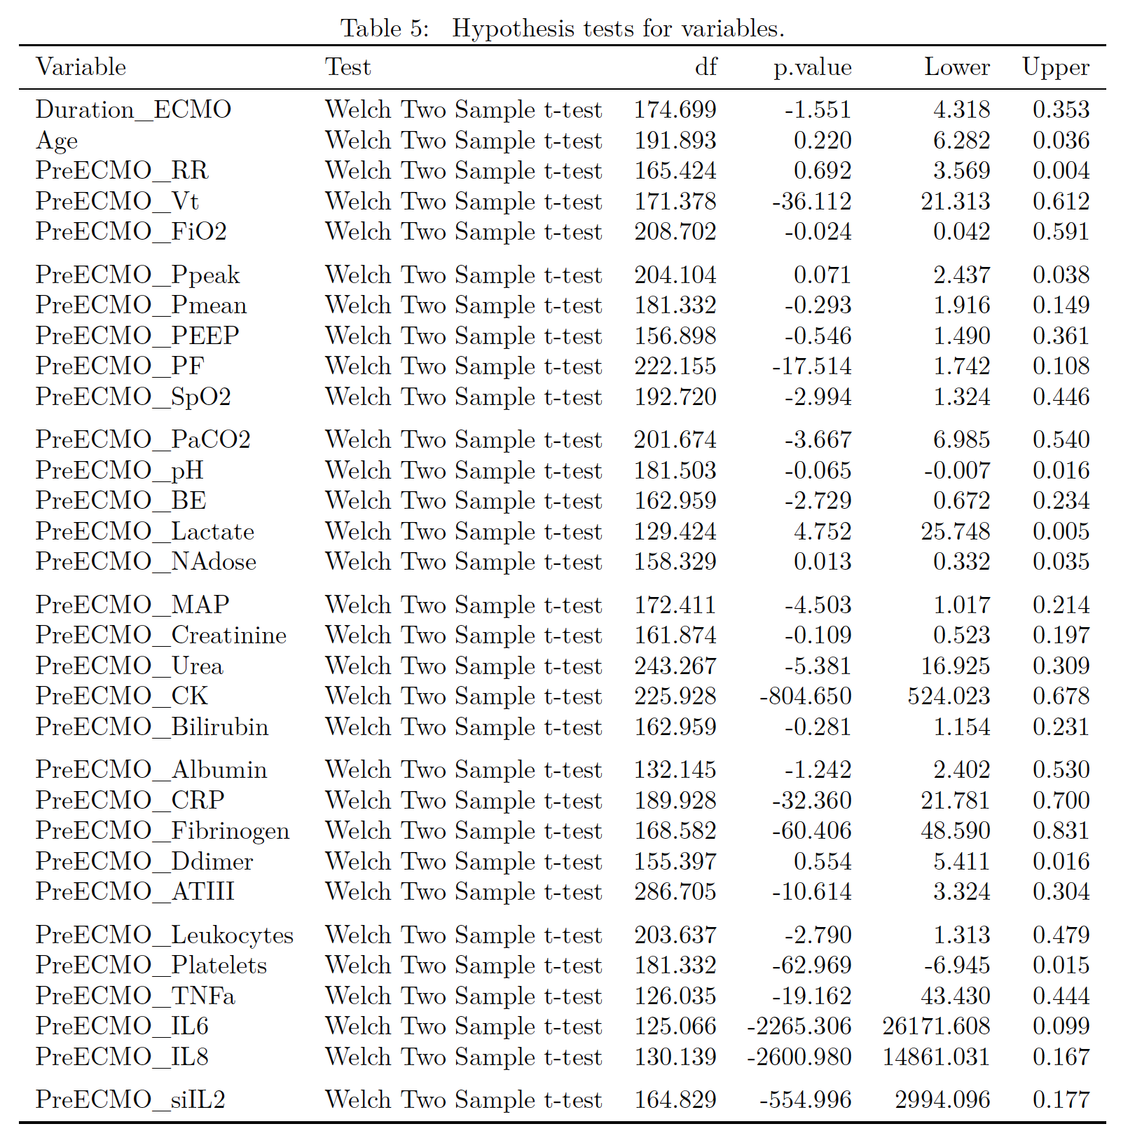
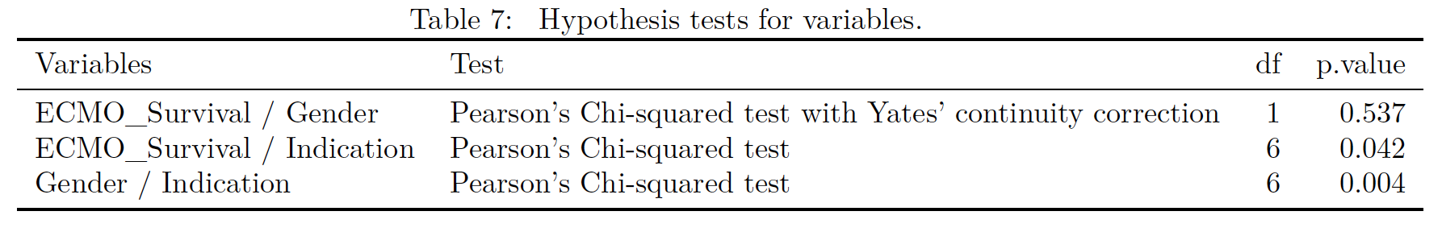
Hypothesis Tests

